Slide 1

Introduction to Property Based Testing
Increase your test coverage and find more bugs, without writing more tests.

Slide 2

What we will cover
Review Traditional testing techniques
Look at some issues with Example Based Testing
Introduce Property Based Testing
Look at some examples
Introduce some tooling
Hands on Kata
Some useful resources (see last slide)
Notes:
Today we are going to learn about a different way of testing our software, called Property Based Testing.
We’ll learn
- what it is, how it differs from traditional testing, and what advantages it offers over traditional testing
we’ll see some examples of how we can write our own Property based tests, which should help explain what Property Based Testing is all about.
We’ll introduce some tooling that should help make our lives easier
- then we’ll put it into practice with the Diamond Kata, using some Property Based tests to assert that our code is working correctly
I’m not expecting you to be experts by the end, I simply want to get you interested in reading more about it and giving it ago.
Indeed, I’m not claiming to be an expert myself, merely and advanced beginner who sees the benefits and wants to share.
Let's get cracking.

Slide 3
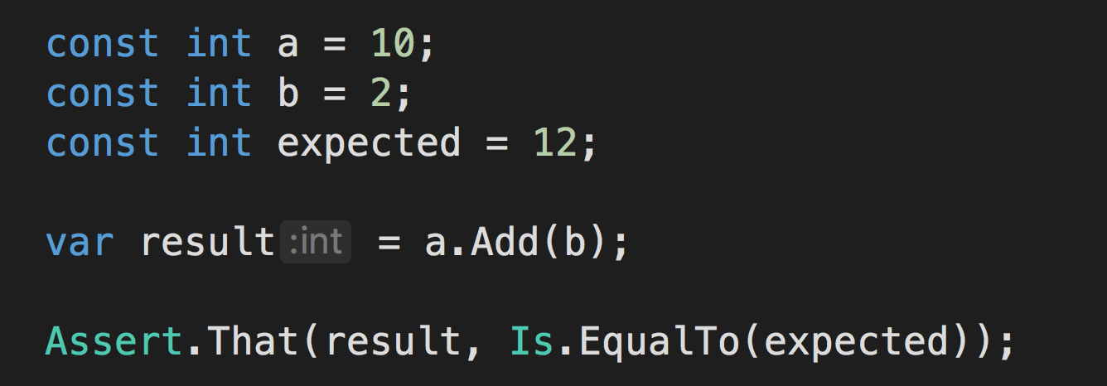
Traditional Testing
TDD
BDD
Arrange
Given
Act
When
Assert
Then
Notes:
Traditional testing:
In the Traditional style of testing that we know and love, or example based testing as I’m going to call it during this workshop, we construct our tests in the form:
given x, when I perform action y, I expect z as a result.
So, given a name of cookie, when I call the HelloWorld() function, I expect to get “Hello, cookie!” Back.
Hopefully we can all recognise that pattern
And hopefully we can all agree that it doesn’t really matter whether you are following test first or test after, TDD or BDD, London style or otherwise - essentially, the pattern is the same.
The implementation details may differ slightly, but we are basically selecting our use cases by hand and modelling these specific scenarios in tests that prove that the subject under test is behaving as desired.

Slide 4

Example Based Testing
Vastly better than no tests at all
But is flawed by a weak link, that
allows bugs to creep in
Notes:
However, there is a slight flaw in the nature of Example Based testing, a weak link.
A weak link that will be exploited by evil little bugs, intent on worming their way into our code, burrowing in deep so that they are hard to find, causing havoc in weird an wonderful ways.
Can you guess that the weak link is?

Slide 5

Example Based Testing
It’s us!
We are are the weak link!
Notes:
It’s us - humans!
Humans are flawed creatures and we make mistakes…some more than others, but none of us is perfect!
We get tired, feel pressure from others to deliver, or apply pressure on ourselves.
Sometimes we are lazy
and sometimes we forget.

Slide 6

Problems with Example Based Testing
Relies on us to:
- think of all scenarios & permutations
- choose valuable test data
- decide how many tests is enough
Costs associated with Exhaustive Testing
Notes:
So the tests we write are only ever as good as we are;
But In order to find bugs, Example Based Testing requires us to think of all the different test scenarios, and all the different data permutations
At a time when we don’t necessarily fully understand the system that we are building.
So the chances are high, that we will miss something, some edge case, or some obscure input that we never imagined would ever happen.
And this is because there is a cost associated with exhaustive testing.
With each new test, we calculate in our heads what the cost of adding that test is: what value it adds, and whether or not it’s worth the effort of creating and maintaining this test.
Again, at a time when we don’t necessarily have accurate data to perform such a calculation….
we are basically making educated guesses and selecting arbitrary use cases!

Slide 7

Problems with Example Based Testing
Q: Did you test all the edge cases?
A: All the ones we thought about, yes!
Notes:
To illustrate this problems let’s quickly walk through an example:

Slide 8

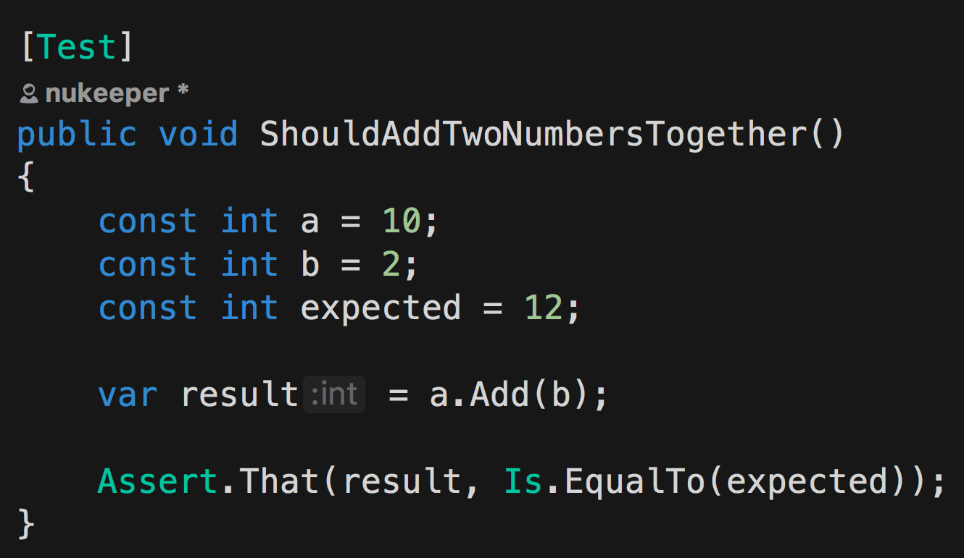
Example Based Tests In Action
Notes:
We need to write a function that will add two values together and return the result….
Sounds fairly simple right.
So, we write our first test: ShouldAddTwoNumbersTogether()

Slide 9
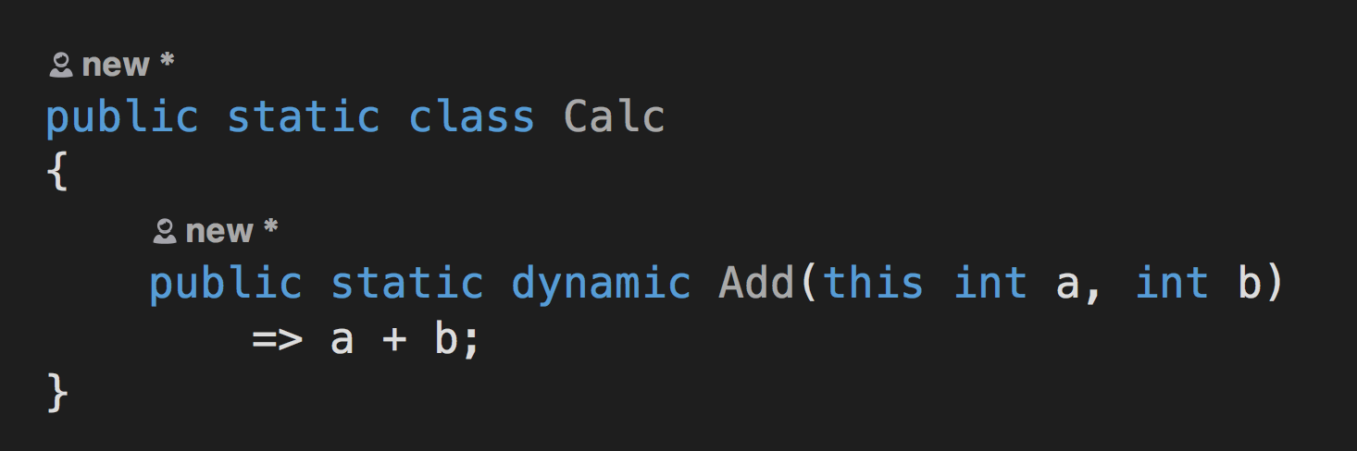
Example Based Tests In Action
Notes:
And following good TDD practise, we run the test and see it fail, then we implement our method and see the test pass.
Are we done?
Are we confident that this works in all scenarios?
…
What about negative numbers?
What about zeros?
What about negative zeros?

Slide 10
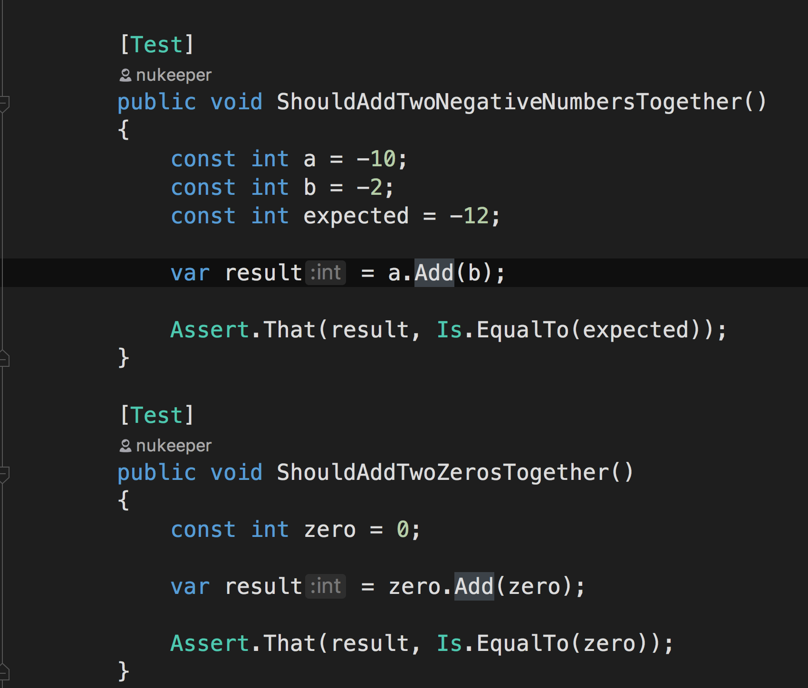
Example Based Tests In Action
Notes:
Ok, so we add a few more tests to cover those scenarios:
They are all green…are we done now? does the function definitely work?
Well what about if we add 1 to int.MaxValue?
If we are using javascript, what happens if a or b is null?
What happens if a or b is not even a number?

Slide 11
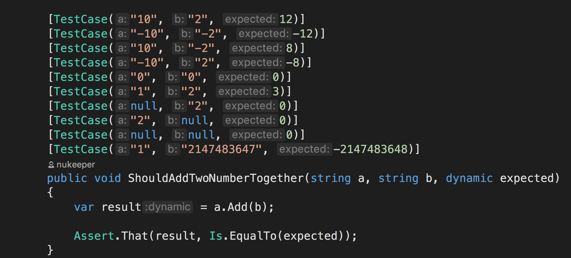
Example Based Testing In Action
Notes:
So we write a few more tests and we end up with something like this (I’ve used dynamic here in order to simulate dynamic typing in Javascript rather that switch to Javascript. Please don’t do this in your code, this is not a recommendation or an endorsement, please use the type system)
We’ve refactored our tests into test cases to reduce the duplication, and we’ve got a lot more tests than we started with.
Great!
…
But are we done?
Where do we stop?

Slide 12
A form of Test Driven Development
Tests executed:
- with randomly generated inputs
- a random number of times
Property
Based Testing
(PBT)
Notes:
Property Based testing is an alternative form of Test Driven Development.
Like example based testing, we can still write our tests up front, and we can still use it to drive out the design of our code and our APIs
But instead of arbitrarily thinking up our test scenarios and hard coding the inputs and expected outputs
Property Based testing
uses randomly generated input data
in order
to execute each test a random number of times. (Let’s say 100 times…for reasons that will become clear shortly)

Slide 13
We don’t know our input data is
Therefore….
We can’t know what to expect in our output will be
PBT: Uses
Randomly Generated Input
Notes:
Let’s focus on the first part of that: Random Test data….
Because our input data is randomly generated, we don’t actually know upfront what our input data is going to be.
And because we don’t know what our input data is going to be, we also have no idea of what the output of our functions under test will be …
PAUSE for thinking time

Slide 14

We don’t know our input data is
Therefore….
We can’t know what to expect in our output will be
PBT: Uses
Randomly Generated Input
Notes:
And now you are probably thinking, ‘well then how are we meant to know if its successful or not?’
And the short answer to that is …that we need to calculate what the answer should be, and assert that the actual result matched the calculated result.

Slide 15
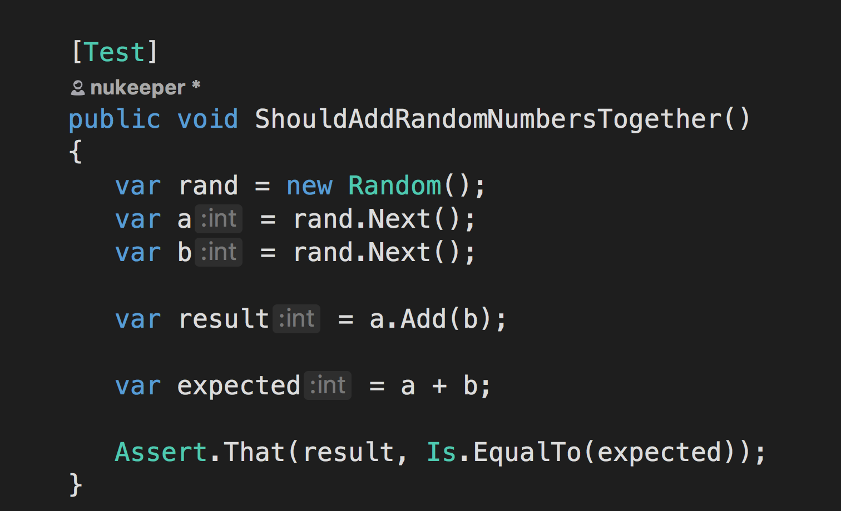
Property Based Testing In Action
Notes:
Ok, so here we have a test that randomly generates the input, pumps it into our Add function to get the result, and also, calculates what the expected result should be.
And this works, but there is an issue with this:
Because I have duplicated the logic from the actual implementation in the test, which breaks the DRY principle,
And this is bad regardless of whether you are writing Example Based Tests or Property Based tests.

Slide 16
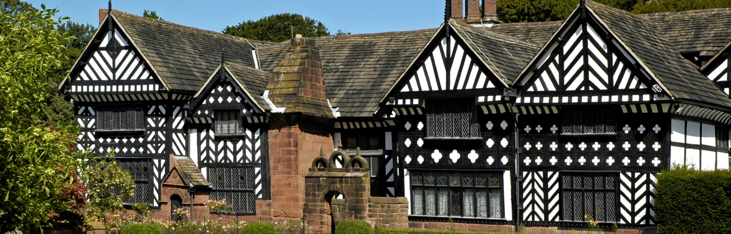
What do we mean by ‘Properties’?
Notes:
Lets take a Segway for a moment, and start by understanding the term Properties.
What do we mean by Properties?
Well, It’s not the getters and setters we see on objects in C# - its got nothing to do with those properties, so put those out of your head
And it’s nothing to do with housing either.
A property is something that is usually described as ‘something that proves to hold true for all valid scenarios’
so you might say that a property is a law, or a rule
Lets walk through an example..

Slide 17
Properties of a GUID Generating Function
f5b9d90e-6885-4375-a645-1ec261aa080f
36 characters long
Contains a mix of upper and lowercase letters, and numbers
No symbols or strange characters - except the 4 hyphens
Always in a particular format
Notes:
Lets say we were building a function to generate a guid
some properties that we could assert are:
- a guid is always 36 characters long
a guid contains a mix of numbers and uppercase and lowercase letters,
no symbols or strange characters except the 4 hyphens we expect at fixed points in the result
- And a guid is always in a particular shape: 5 parts- the 3 in the middle are always 4 characters long, the one at the start is always 8 chars long, and the last part is always 12 chars long
And If we were to write a test to assert that each of these rules held true for 100 randomly generated GUIDS (which would total 400 test cases) then we could say with a high confidence that the thing being generated by the function was actually, in fact, a GUID
So what are some of the Properties of the Add function that we could test for?
Lets work through a few examples

Slide 18
Properties of an Add Function
The order of the input arguments does not matter:
A + B == B + A
5 + 8 == 8 + 5
Notes:
Lets say that, for Add to be implemented correctly, then the order of the two parameters does not matter: The result of A + B should be the same as B + A
That is our rule, or our property, that we are asserting.

Slide 19
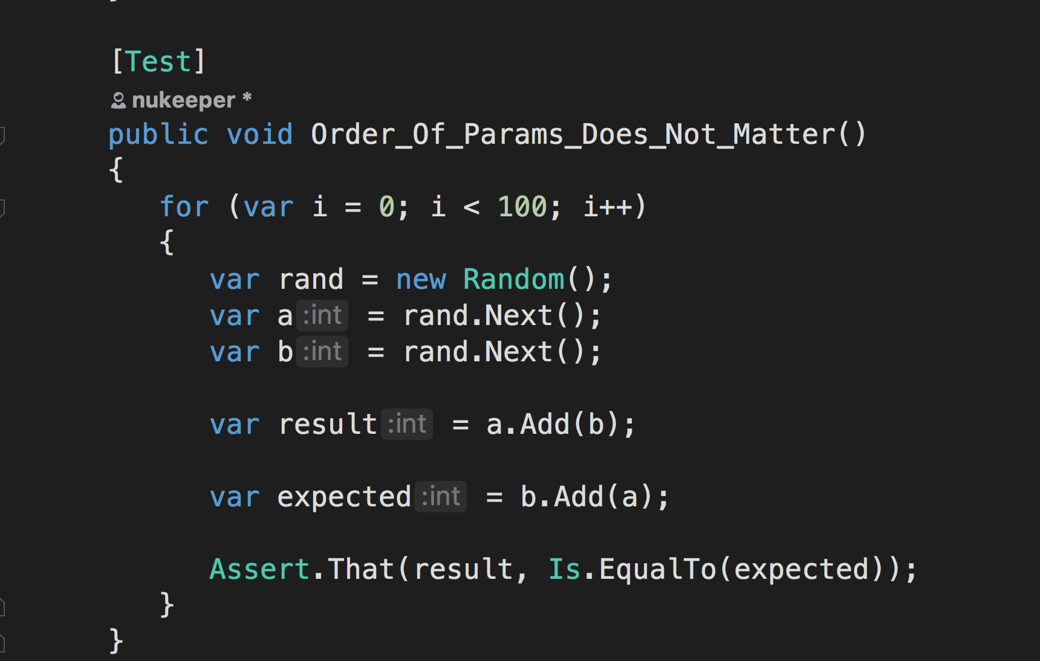
Properties of an Add Function
Notes:
Here we see that property (or rule) expressed in C#:
So here we are asserting that, when calling Add, regardless of which order we supply our arguments, we get the same result…
What does this tell us?
If this rule holds true for 100 random test cases, what can we prove or disprove about our implementation of Add?

Slide 20
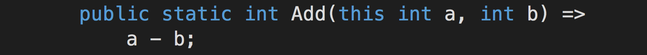
Properties of an Add Function
5 - 8 != 8 - 5
Notes:
Well, it does rule out the possibility that Add actually does returns a - b;
Because with subtraction, the order of the arguments DOES matter.
The result of 8 - 5 is not the same as 5 – 8, so our test would fail if we had implemented our function this way.
But on its own, it does not give us complete confidence that our method is 100% correct.
For example, if we accidentally implemented Add as a * b then this test would still pass, because 5*8 is the same as 8*5.
So we need another test.

Slide 21
Properties of an Add Function
For any valid integer (x),
calling Add(1) twice is the same as calling Add(2) once:
x + 1 + 1 == x + 2
Notes:
What else can we say about Add?
Well, we could say that for any valid integer X, the result of calling Add(1) twice is the same calling Add(2) once:
x + 1 + 1 == x + 2

Slide 22
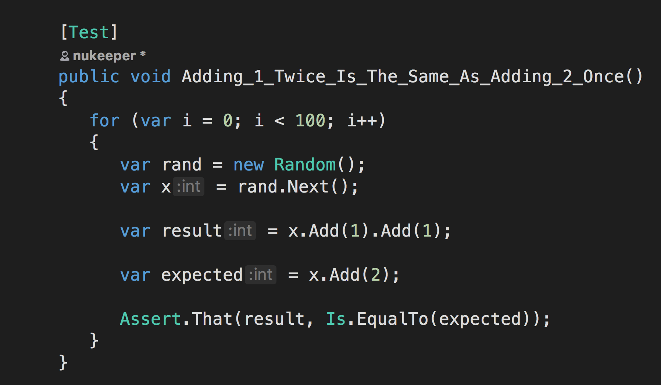
Properties of the Add Function
Notes:
Here is that test expressed in C#, and this test passes.
So with these 2 tests (which have actually generated 200 test cases), we can be fairly sure that our implementation of Add is working correctly.
…
But there is actually still a scenario we’ve not catered for.
If we had accidentally implemented Add to simply return 0, then these 2 tests will still pass, but obviously our function isn’t working.
So we need another test.

Slide 23
Properties of an Add Function
For any valid integer (x),
the result of calling Add(0) is the same as x :
x + 0 == x
Notes:
Another Property we could test for is; that for any valid integer X, adding zero to X is the same as X itself
x + 0 == x

Slide 24
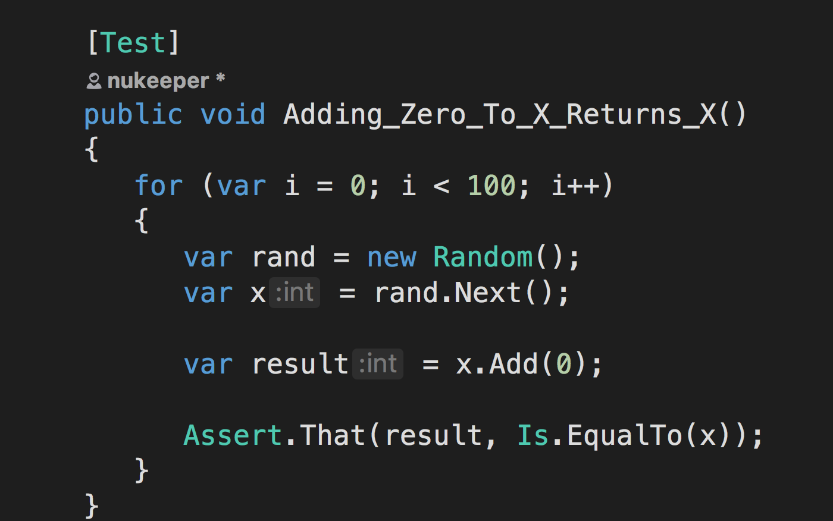
Notes:
Here it is in C#
Now with the combination of these 3 tests, which actually cause 300 random tests to execute, we can be fairly sure that our implementation of the Add method is working properly.
…
And that, in a nut shell, is Property Based Testing:
We run a test a random number of times, with random input data, and ensure that the expected properties, or rules, hold true for all cases.
And sometimes, we need a combination of properties in order to be confident of our implementation.

Slide 25
Benefits of Property Based Testing
More test coverage
More edge cases covered
More comprehensive then humans
Notes:
So what benefits do we get?
Well, we are now running a lot more tests over our code each time we run the tests, both locally and on the CI server.
And the random nature of the input data means that we are getting machines to replace our flawed human brains when selecting test cases:
They don’t get tired, they don’t feel pressure, and they don’t forget….so as a result, they will end up running far more weird and wonderful tests than we were ever willing to write code for….
And as a result, the chances of finding a bug in your implementation goes up.
And we’ve actually written LESS tests that we did before….so there is less code to maintain!!

Slide 26
Boiler plate setup = noise
Test failure diagnosis = murder
What about non-numeric data input?
Non-Deterministic test runs!!
Flawed Implantation
Notes:
However, there are obviously a few issues here:
- first, we are doing quite a lot of work in order to setup the test: all those loops inside the test is duplication we could do without, and frankly, distracts from what the test is actually trying to do
with the code as it, If one of the random test cases fails, then diagnosing which of the randomly generated inputs caused the failure is going to be a pain, and we may have to add more noise in the form of logging in order to figure it out
Generating random integers is pretty easy, but what if we wanted something more complicated than primitive data types?
You may also be thinking that our tests are no longer deterministic….because of the randomly generated data, it is possible that they could fail intermittently. And you’d be right…..but the chances are that this is due to a defect that you didn’t know was there, and that, my friends, is the point!
If we are to start using PBT then we need to learn to listen to our tests: we can’t blindly re-run them to see if the error goes away – and we cannot accept flaky tests that drive such behaviour!
So we can learn to accept non-determinism, but what about the other issues?

Slide 27
FS Check to the rescue!
“Quick Check” is a Property Based Testing framework
Originally built for Haskell
Ported to many different languages
FS Check is the .Net implementation
Ports available for Python, Scala &
Javascript: https://github.com/jsverify/
Notes:
Enter FS Check.
Luckily there are tools out there that address these issues and make writing Property Based Tests much cleaner and quicker to do
FS Check is Library based on something called QuickCheck, which was originally created for Haskell, but has been ported to many different languages:
I’ve included some links to what a very quick google uncovered, but I’ve not tested that any of them are any good.
The links can be found on the resources slide at the end of this deck.
FS Check will automatically generate our random data for us, not just for primitive types like integers, but can actually generate complex data structures for use too.
It will also manage the running of our tests multiple times for us, the default is 100 times, but you can configure that if you like.
FS Check will keep running tests until it runs out of test cases (either it hits the desired target, or it exhausts the dataset), or until it finds a failing test case.
If and when it finds a failing test case, it’s output helps you understand which one failed, without any additional logging from us.
So its a pretty nifty bit of kit, and resolves a lot of the issues we were discussing before!

Slide 28
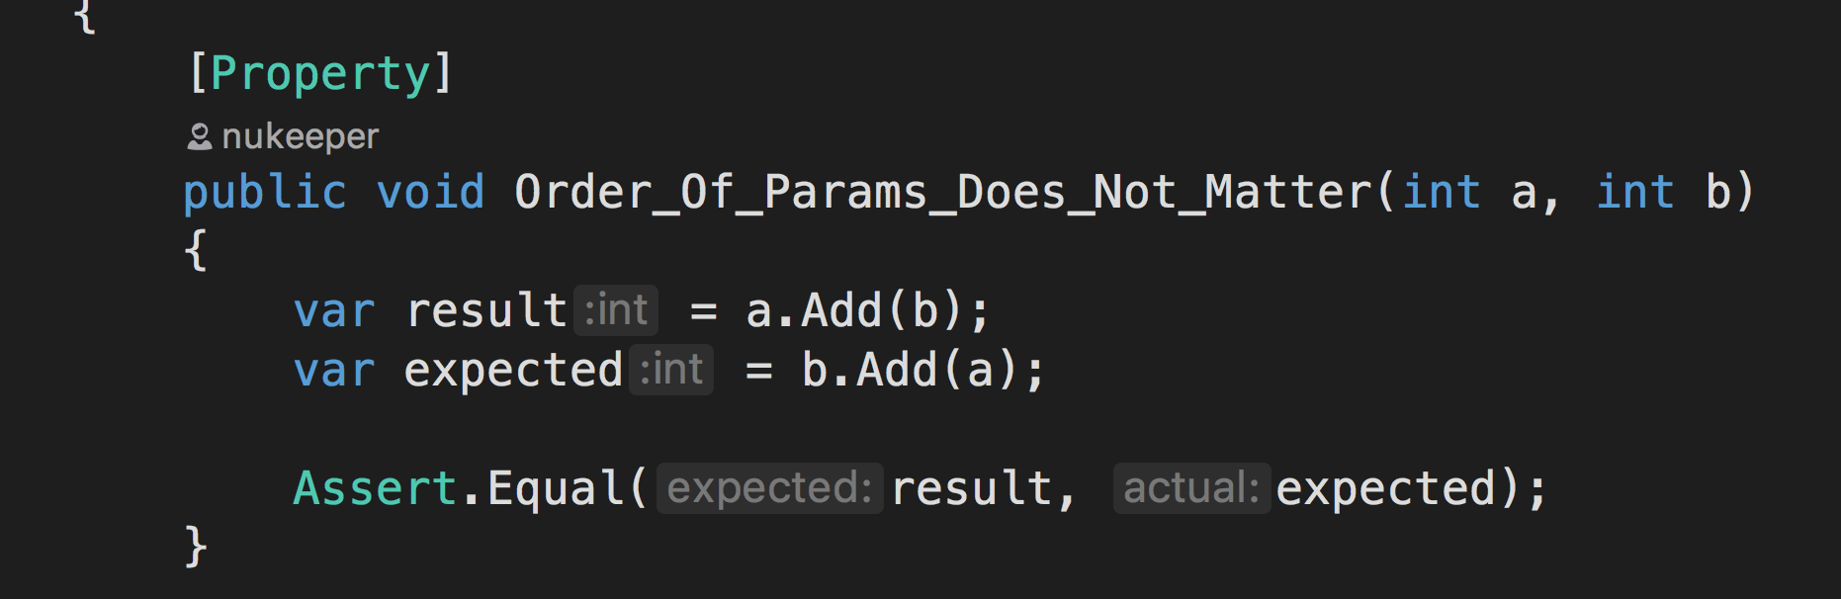
FS Check to the rescue!
Notes:
And here is one of our tests now that we’ve added a reference to the FS Check package:
Let’s walk through the changes:
First, The test is now decorated with a Property attribute instead of the previous Test attribute - this tells FSCheck that we want it to manage our test for us
Next, our input data is now supplied to the test as an argument, just like when we create test cases with NUnit, but in instead of creating the test cases ourselves, FSCheck will be generating the input for us.
Lastly, we’ve done away with all that noisy looping logic, as FSCheck is managing that for us.
And the Random object is gone too as it’s now redundant.
Overall, a lot cleaner and nicer to read.

Slide 29

Now it’s your turn:
Hands On!
Notes:
So now you have an idea of what Property Based Testing is all about, and you’ve had a glimpse of how to do it,
hopefully I’ve managed to peek your interest just enough that you want to get your hands dirty.
That’s exactly what we are going to do now.
We are going to have a crack at doing the Diamond Kata, using Test Driven Development, but instead of Example Based Tests, we are going to use Property Based Tests.
But before we start,
we need to first answer any questions you might have at this stage, then understand the problem a little more:

Slide 30
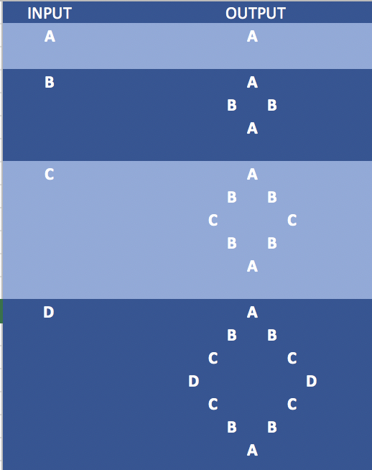
The Diamond Kata
Build a function that:
Takes in a single character from the alphabet as input
Returns a diamond shape ASCII picture starting at A, all the way to the input letter, and back down to A again.
Notes:
The Diamond Kata:
Take a single character from the alphabet as input, and as output, return a diamond shape ascii picture starting at A, all the way to the input Letter, and back down to A again:
So each row of the picture will be a string, and the overall response object will be a collection of strings.
The only valid inputs are the characters a-z, regardless of case.
Any Questions about the requirements?

Slide 31

What Properties to test for?
Notes:
Now, the hardest part of starting with PBT is figuring out what properties to test for, so, before we start let’s take 5 minutes to think of some properties that we might be able to test for in our output.
Remember these are rules that will be true for all valid inputs, and we don’t actually know what the input is going to be.

Slide 32
Let’s write some code!
https://github.com/dcook-net/PropertyBasedTesting/

Slide 33
Scott Wlaschin’s Posts:
Introduction to Property Based Testing
Choosing Properties to Test
Or a video on youtube of
the above two posts
The FS Check github Repo
Quick Check ports in:
Javascript
Python
Scala
Resources

